Slide 1
CISP 002 - Basic Personality Traits

Slide 2
Introduction
Personality traits reflect people’s characteristic patterns of thoughts, feelings, and behaviors.
Personality traits imply consistency and stability—someone who scores high on a specific trait like Extraversion is expected to be sociable in different situations and over time.
Thus, trait psychology rests on the idea that people differ from one another in terms of where they stand on a set of basic trait dimensions that persist over time and across situations.

Slide 3
The most widely used system of traits is called the Five-Factor Model.
This system includes five broad traits that can be remembered with the acronym OCEAN: Openness, Conscientiousness, Extraversion, Agreeableness, and Neuroticism.
Each of the major traits from the Big Five can be divided into facets to give a more fine-grained analysis of someone's personality.

Slide 4
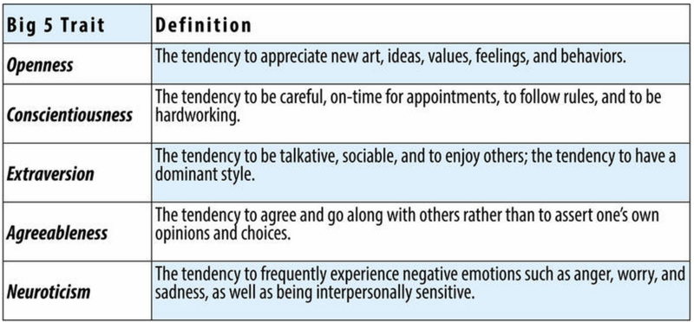

Slide 5
Determining Personality Types
Openness: appreciation for a variety of experiences.
Conscientiousness: planning ahead rather than being spontaneous.
Extraversion: being sociable, energetic and talkative.
Agreeableness: being kind, sympathetic and happy to help.

Slide 6
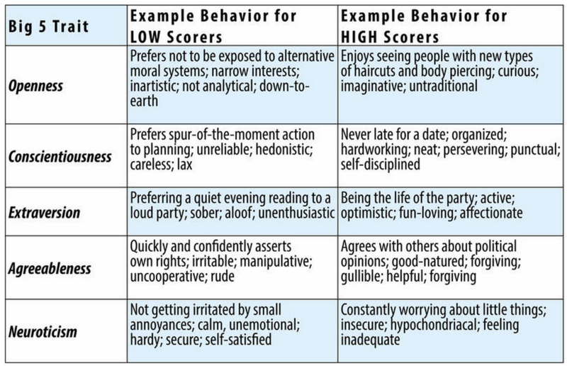

Slide 7
There are three criteria that are characterize personality traits: (1) consistency, (2) stability, and (3) individual differences.
1. To have a personality trait, individuals must be somewhat consistent across situations in their behaviors related to the trait. For example, if they are talkative at home, they tend also to be talkative at work.

Slide 8
2. Individuals with a trait are also somewhat stable over time in behaviors related to the trait. If they are talkative, for example, at age 30, they will also tend to be talkative at age 40.
3. People differ from one another on behaviors related to the trait.
Using speech is not a personality trait and neither is walking on two feet—virtually all individuals do these activities, and there are almost no individual differences.
But people differ on how frequently they talk and how active they are, and thus personality traits such as Talkativeness and Activity Level do exist.

Slide 9
Personalities are characterized in terms of traits, which are relatively enduring characteristics that influence our behaviour across many situations.
Personality traits such as introversion, friendliness, conscientiousness, honesty, and helpfulness are important because they help explain consistencies in behaviour.
Because the recognition and memories of life experiences might influence our thoughts, feelings, behaviors, and accordingly, personality traits

Slide 10
Personality development refers to how the organized patterns of behavior that make up each person's unique personality emerge over time.
Many factors go into influencing personality, including genetics, environment, parenting, and societal variables.

Slide 11
The major determinants of personality of an individual can be studied under four broad heads – biological, family, cultural and situational.
One's personality is shaped by a combination of nature (genetic) and nurture (environmental) influences.

Slide 12
Thank you

